Slide 1

Sprocket Central Pty Ltd
Data analytics approach
[Division Name] - [Engagement Manager], [Senior Consultant], [Junior Consultant]

Slide 2
Agenda
Table of Contents
Introduction
Data Exploration
Model Development
Interpretation

Slide 3
Agenda
Focus Areas
Age Group
Car Ownership
Wealth Segment
Job Industry
State

Slide 4
Introduction
Data Cleaning
 | list_price | standard_cost | profit | past_3_years_bike_related_purchases
count | 19963.000000 | 19773.000000 | 19963.000000 | 19963.000000
mean | 1107.794215 | 556.091050 | 556.995822 | 48.752392
std | 582.862930 | 405.966472 | 497.081495 | 28.611332
min | 12.010000 | 7.210000 | 4.800000 | 0.000000
25% | 575.270000 | 215.140000 | 135.850000 | 24.000000
50% | 1163.890000 | 507.580000 | 445.210000 | 48.000000
75% | 1635.300000 | 795.100000 | 830.240000 | 73.000000
max | 2091.470000 | 1759.850000 | 2086.070000 | 99.000000
Excel was used to identify the data quality issues and pre-process the data for further analysis.
The cleaned table data were merged into one table in Python.
Table: Statistical details of the financial values in the dataset

Slide 5
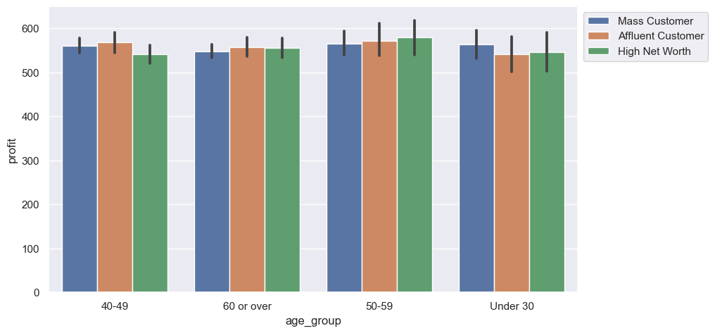
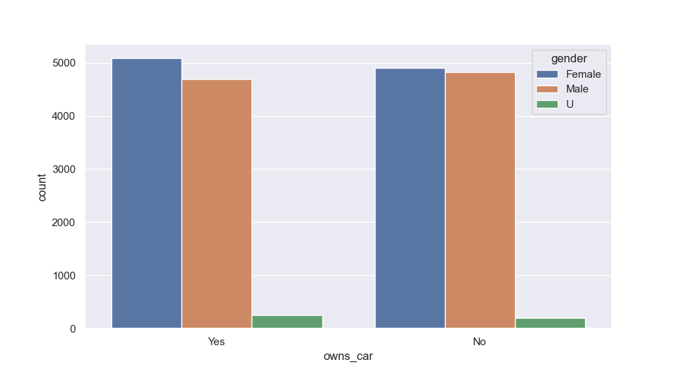
Data Exploration
Gender & Age factors
Age group 50-59 has the highest contribution of age group and wealth segment to profit.
Car ownership is more positive among males and more negative among females.

Slide 6
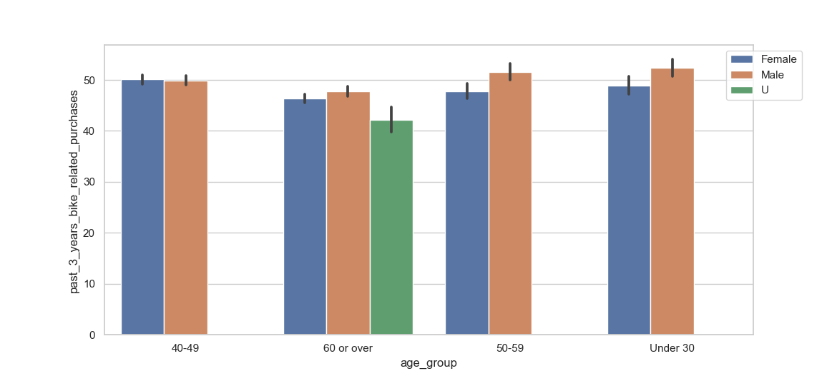
Data Exploration
Gender & Age factors
In the last 3 years, the most purchases are from under 30 males.
More male customers own cars than that of the female customers.

Slide 7
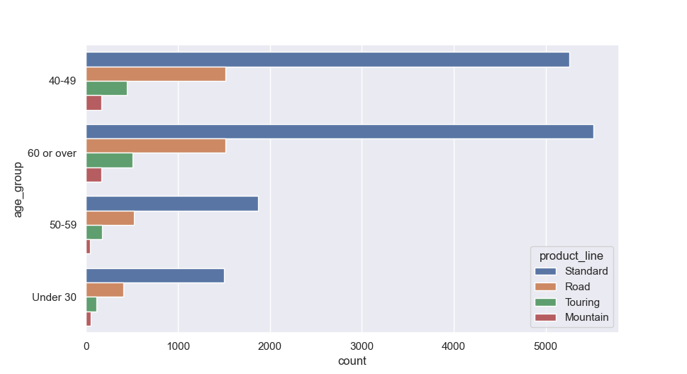
Data Exploration
Gender & Age factors
Standard bikes are ordered the most by all age groups whereas Mountain bikes are the lowest.
Road bikes are the second most ordered items followed by Touring bikes which are famous among the age group “60 or over”.

Slide 8
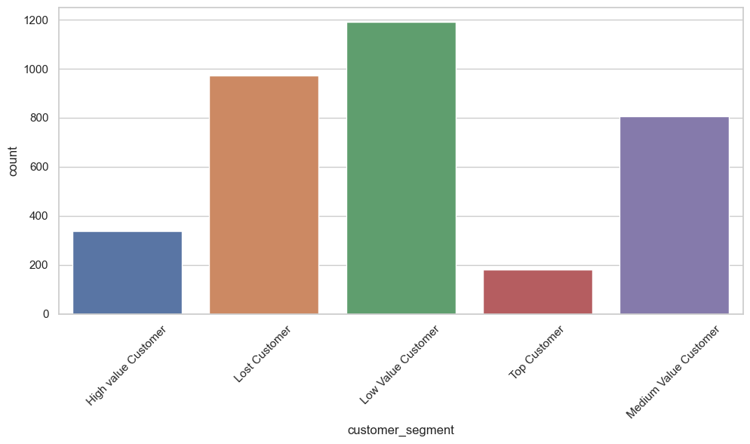
Model Development
RFM Analysis
Most of the customers are Low Value customers which should be a concern for further analyses.
For new customers, the characteristics and tendencies of Top, High Value and Medium Value customers will be considered.

Slide 9
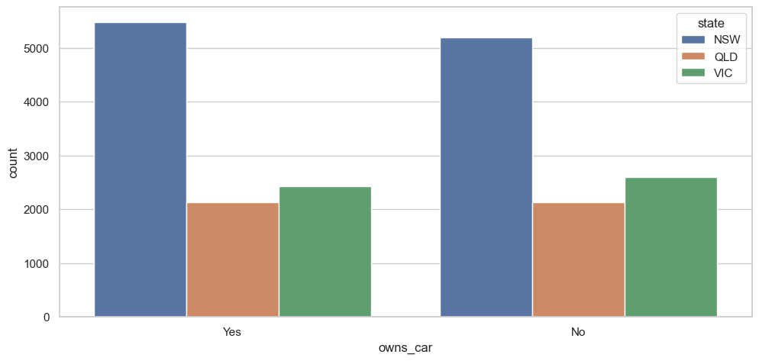
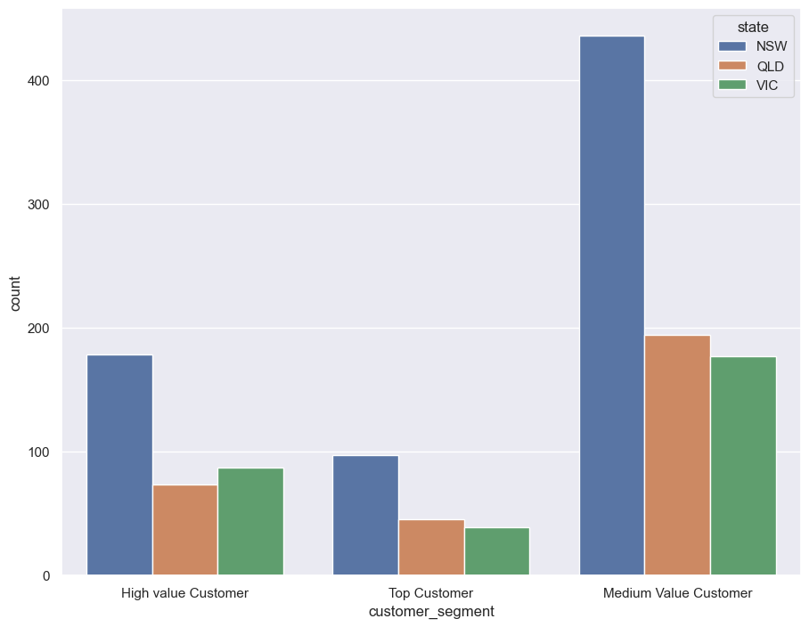
Model Development
RFM Analysis
Majority of the important customers are from New South Wales, followed by QLD and VIC.
The ownership of the car has almost equal count in all the states.

Slide 10
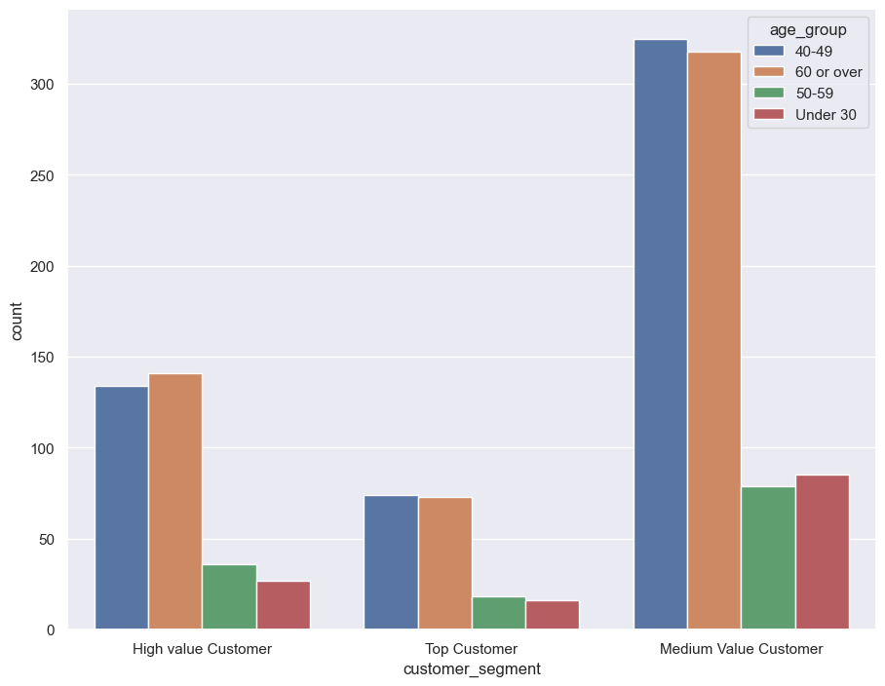
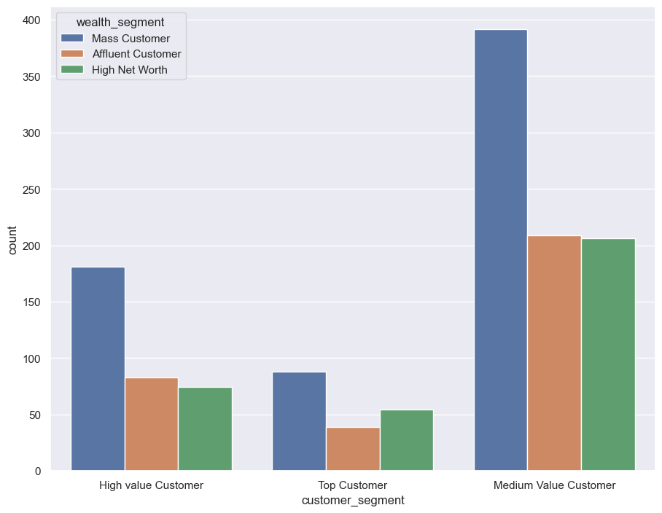
Model Development
RFM Analysis
Most of the customers are in the age group 40-49 and 60 or over.
High net worth and Affluent customers have less contribution than mass customers.

Slide 11
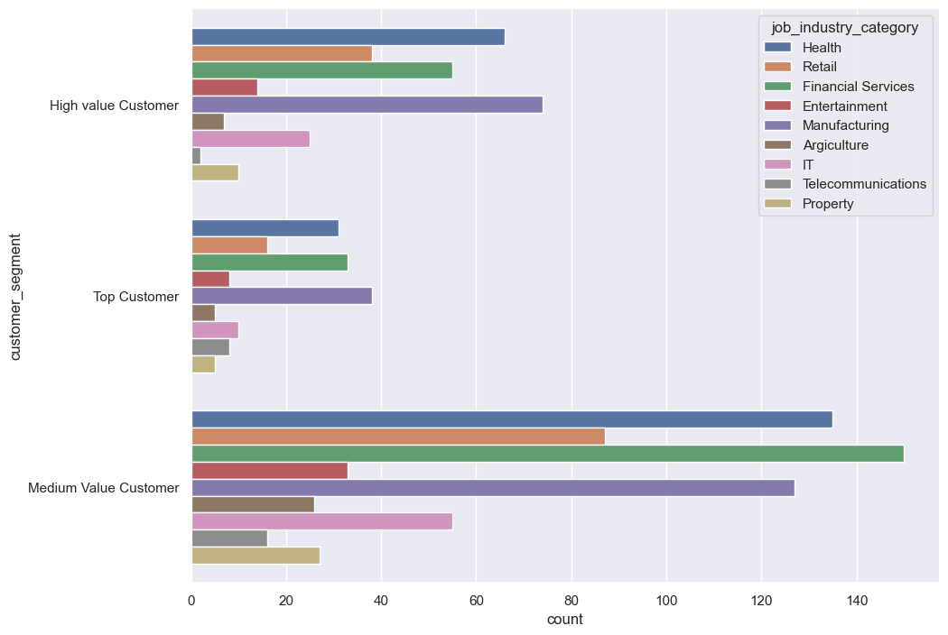
Model Development
RFM Analysis
In all three segments, Health, Financial Services and Manufacturing are the highest profit generating industries.
Retail and IT industries also have noticeable contribution among three segments.

Slide 12
Interpretation
Potential Customer Classification
Top 3 job industries to target – Health, Manufacturing, and Financial Services
People are 40 and over should be the main target.
Wealth segment and car ownership have less impact on purchase. Mass customers are the main consumer.
New South Wales has a big potential market for growth.

Slide 13
Note: The data and information in this document is reflective of a hypothetical situation and client. This document is to be used for KPMG Virtual Internship purposes only.
Thank You

